Slide 1
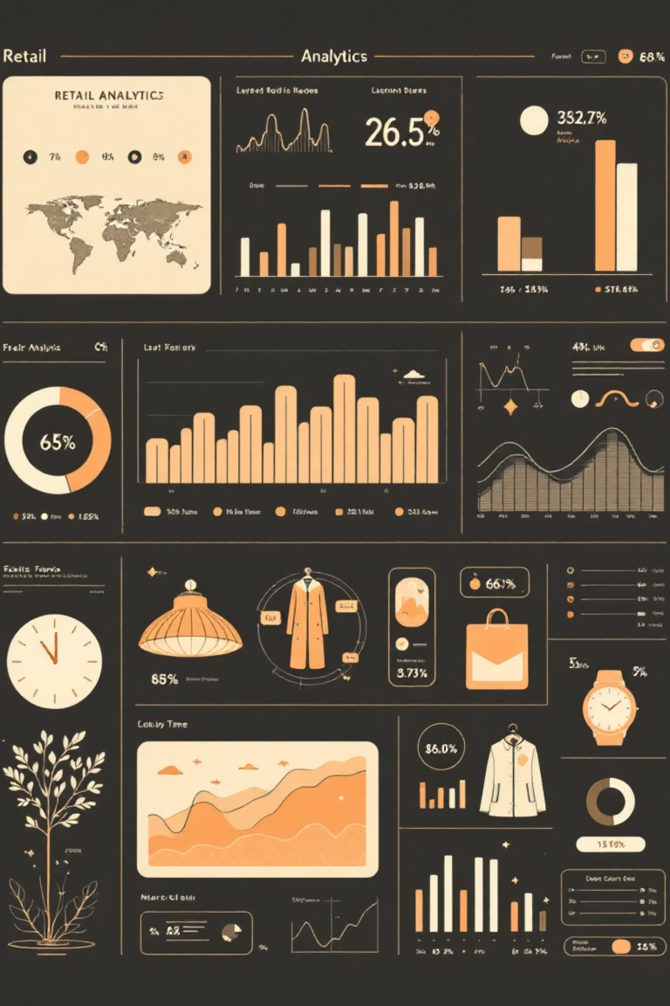
Customer Shopping Behavior Analysis
Uncovering insights from 3,900 purchases to drive strategic business decisions

Slide 2

Dataset Overview
3,900
18
50
Total Purchases
Data Columns
Locations
Transactions analyzed across all categories
Comprehensive customer and purchase attributes
Geographic diversity in customer base
25
Product Types
Wide variety of items purchased

Slide 3
Data Preparation Journey
01
02
Data Loading & Exploration
Missing Data Handling
Imported dataset using pandas, analyzed structure with df.info() and summary statistics
Imputed 37 missing Review Rating values using median rating per category
03
04
Feature Engineering
Database Integration
Created age_group bins and purchase_frequency_days columns for deeper insights
Connected to PostgreSQL and loaded cleaned data for SQL analysis

Slide 4
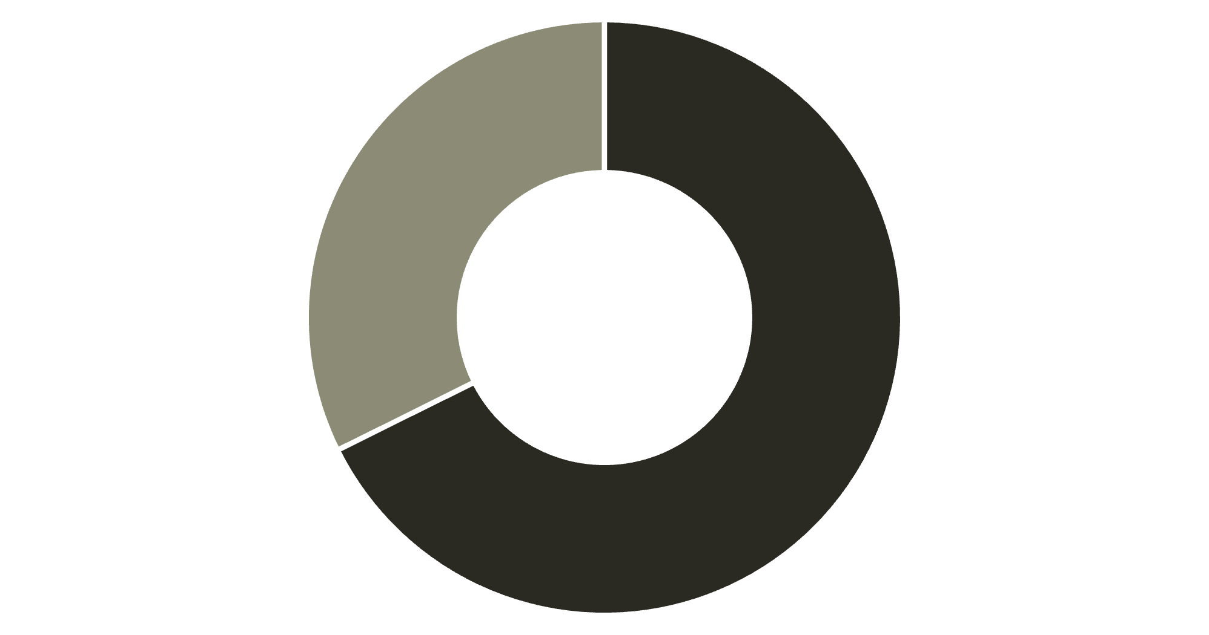
Revenue by Gender
Male Customers Drive Revenue
Male customers generate 68% of total revenue, more than double female contribution
Strategic opportunity to increase female customer engagement
Male
Female

Slide 5

Top-Rated Products
Gloves
Sandals
Boots
3.86 rating
3.84 rating
3.82 rating
Hat
Skirt
3.80 rating
3.78 rating
Highest average review ratings reveal customer favorites for marketing focus

Slide 6

Shipping & Spending Patterns
Express Shipping
Standard Shipping
$60.48
$58.46
Average purchase amount
Average purchase amount
Express shipping customers spend 3.5% more on average—target for premium campaigns

Slide 7



Customer Segmentation Insights
New
1
83
Returning
2
701
Loyal
3
3,116
80% of customers are loyal buyers—retention strategies are working, but new customer acquisition needs attention

Slide 8


Subscription Status Analysis
27%
73%
Subscribers
Non-Subscribers
1,053 customers with $59.49 average spend
2,847 customers with $59.87 average spend
Repeat Buyers with Subscriptions
Repeat Buyers without Subscriptions
958 customers with 5+ purchases are subscribers
2,518 customers with 5+ purchases—huge conversion opportunity

Slide 9
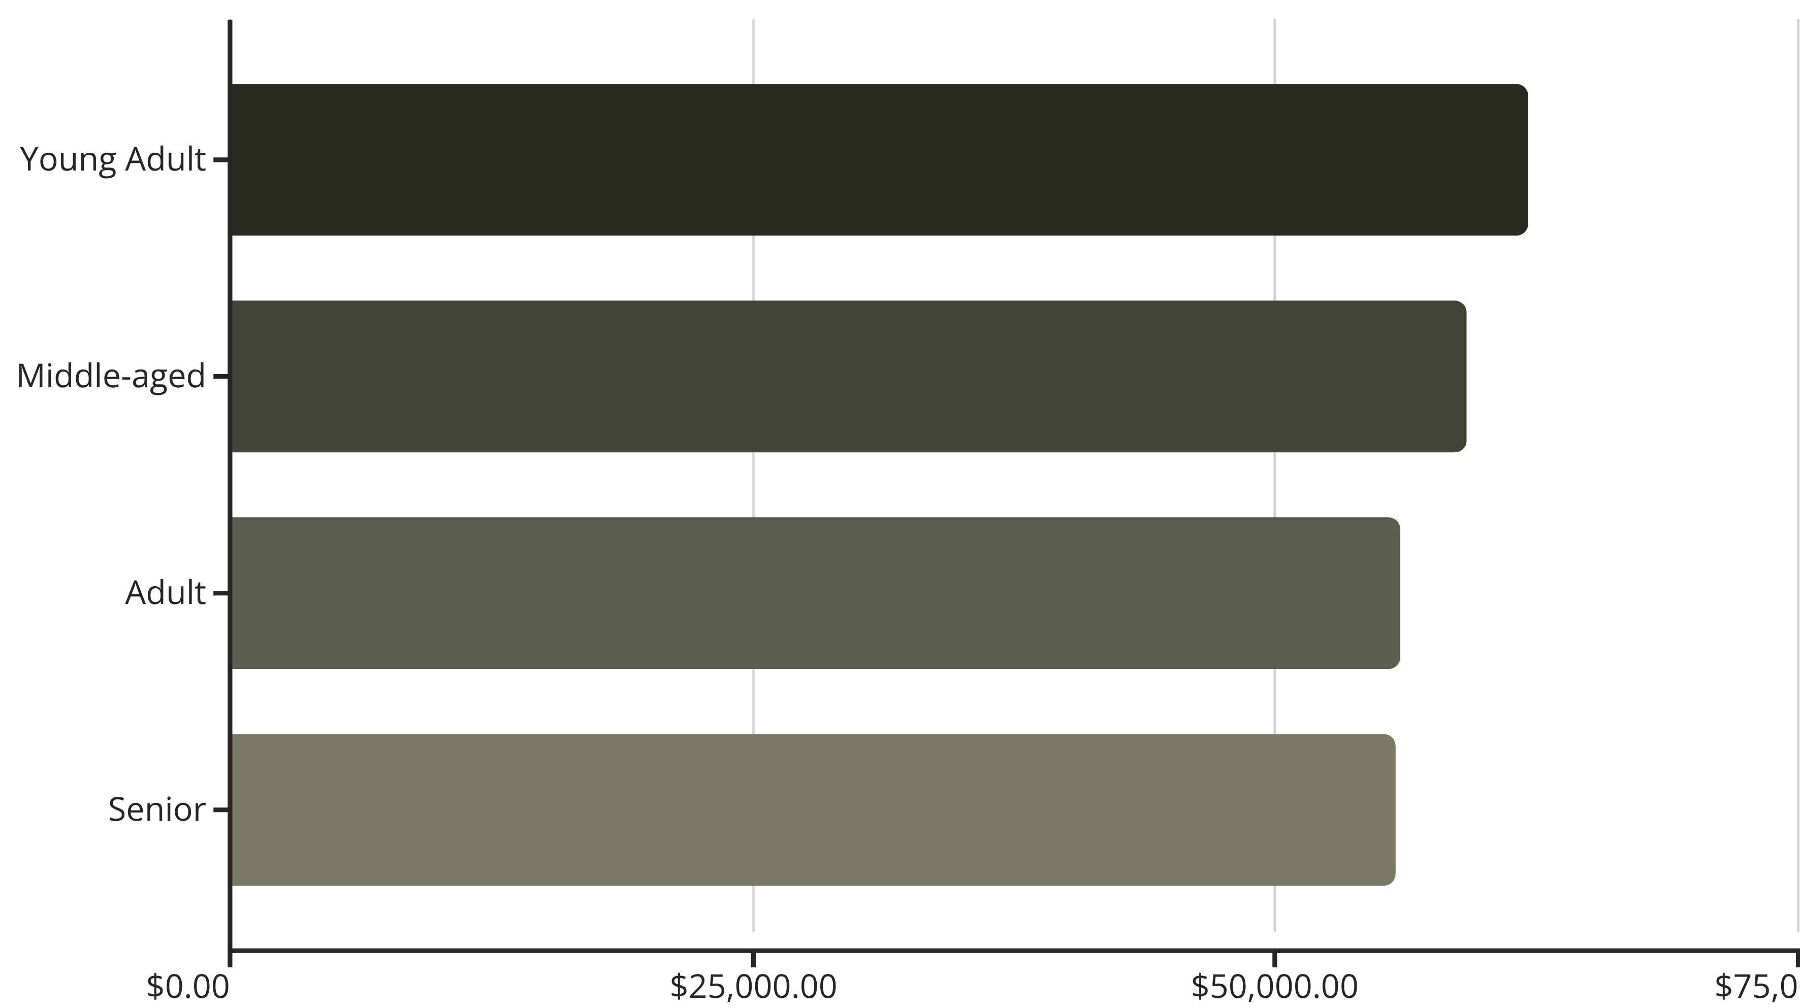
Revenue by Age Group
Young adults lead revenue generation—focus marketing efforts on this demographic

Slide 10
Strategic Recommendations
Boost Subscriptions
Customer Loyalty Programs
Review Discount Policy
Convert 2,518 repeat buyers without subscriptions through exclusive benefits
Reward repeat buyers to strengthen the loyal segment
839 high-spending discount users—balance promotions with margin control
Product Positioning
Targeted Marketing
Highlight top-rated items like Gloves and Sandals in marketing campaigns
Focus on young adults and express-shipping users for premium offerings

